Slide 1

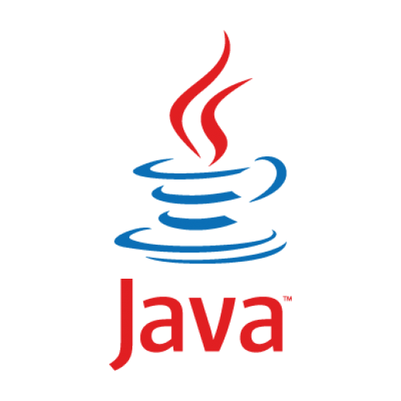
Method Reference
#21
Java
Programming

Slide 2
Method Reference Example
Example01
public class MethodReferenceExample {
// Classname :: methodName
public static void main(String[] args) {
System.out.println("Result 1 :"+MethodReferenceExample.compare(50, 60));
Comparator<Integer> comp = MethodReferenceExample::compare;
System.out.println("Result 2:"+comp.compare(50, 60));
}
public static int compare(Integer x,Integer y) {
return Integer.compare(x, y);
}
}
/opt/jdk-11.0.9/bin/java
Result 1 :-1
Result 2:-1

Slide 3
Method Reference Company Example
Example02
public class MethodReferenceCompanyExample1 {
static Function<String, String> f1 = name -> name.toUpperCase();
static Function<String, String> f2 = String::toUpperCase;
static Predicate<Company> p1 = per -> per.getQtyEmployee() >=100000;
static Predicate<Company> p2 = MethodReferenceCompanyExample1:: qtyEmployeeCheck;
static BiPredicate<Company,Integer> p3 = MethodReferenceCompanyExample1::qtyEmployeeCheckWithParam;
static Function<String,String> f3 = MethodReferenceCompanyExample1::sayMyNameCompany ;
public static void main(String[] args) {
System.out.println("Lambda Expression Result :"+f1.apply("java 11"));
System.out.println("Method Reference Result :"+f2.apply("java 11"));
System.out.println("Predicate 1 Result :"+p1.test(CompanyRepository.getCompany()));
System.out.println("Predicate 2 Result :"+p2.test(CompanyRepository.getCompany()));
System.out.println("Predicate 3 Result :"+p3.test(CompanyRepository.getCompany(),950000));
System.out.println("Function Test :"+f3.apply("java8"));
}
static boolean qtyEmployeeCheck(Company per) { return per.getQtyEmployee() >= 100000; }
static boolean qtyEmployeeCheckWithParam(Company per, Integer qtyEmployee) {
return per.getQtyEmployee() >= qtyEmployee;
}
static String sayMyNameCompany(String name){ return "Company: "+name; }
}
/opt/jdk-11.0.9/bin/java
Lambda Expression Result :JAVA 11
Method Reference Result :JAVA 11
Predicate 1 Result :false
Predicate 2 Result :false
Predicate 3 Result :false
Function Test :Company: java 11

Slide 4
Method Default Vs Static Example
Example02
public class MethodReferenceCompanyExample1 {
static Function<String, String> f1 = name -> name.toUpperCase();
static Function<String, String> f2 = String::toUpperCase;
static Predicate<Company> p1 = per -> per.getQtyEmployee() >=100000;
static Predicate<Company> p2 = MethodReferenceCompanyExample1:: qtyEmployeeCheck;
static BiPredicate<Company,Integer> p3 = MethodReferenceCompanyExample1::qtyEmployeeCheckWithParam;
static Function<String,String> f3 = MethodReferenceCompanyExample1::sayMyNameCompany ;
public static void main(String[] args) {
System.out.println("Lambda Expression Result :"+f1.apply("java 11"));
System.out.println("Method Reference Result :"+f2.apply("java 11"));
System.out.println("Predicate 1 Result :"+p1.test(CompanyRepository.getCompany()));
System.out.println("Predicate 2 Result :"+p2.test(CompanyRepository.getCompany()));
System.out.println("Predicate 3 Result :"+p3.test(CompanyRepository.getCompany(),950000));
System.out.println("Function Test :"+f3.apply("java8"));
}
static boolean qtyEmployeeCheck(Company per) { return per.getQtyEmployee() >= 100000; }
static boolean qtyEmployeeCheckWithParam(Company per, Integer qtyEmployee) {
return per.getQtyEmployee() >= qtyEmployee;
}
static String sayMyNameCompany(String name){ return "Company: "+name; }
}
/opt/jdk-11.0.9/bin/java
Lambda Expression Result :JAVA 11
Method Reference Result :JAVA 11
Predicate 1 Result :false
Predicate 2 Result :false
Predicate 3 Result :false
Function Test :Company: java 11

Slide 5


